Slide 1
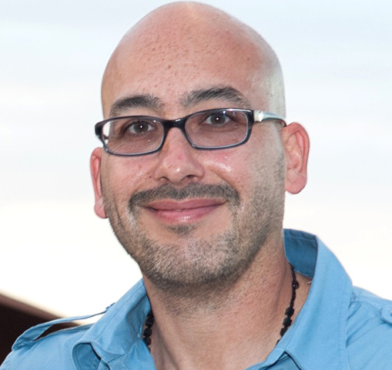
John 19.16b-30
Jose Rosario; photo from The New York Post

Slide 2
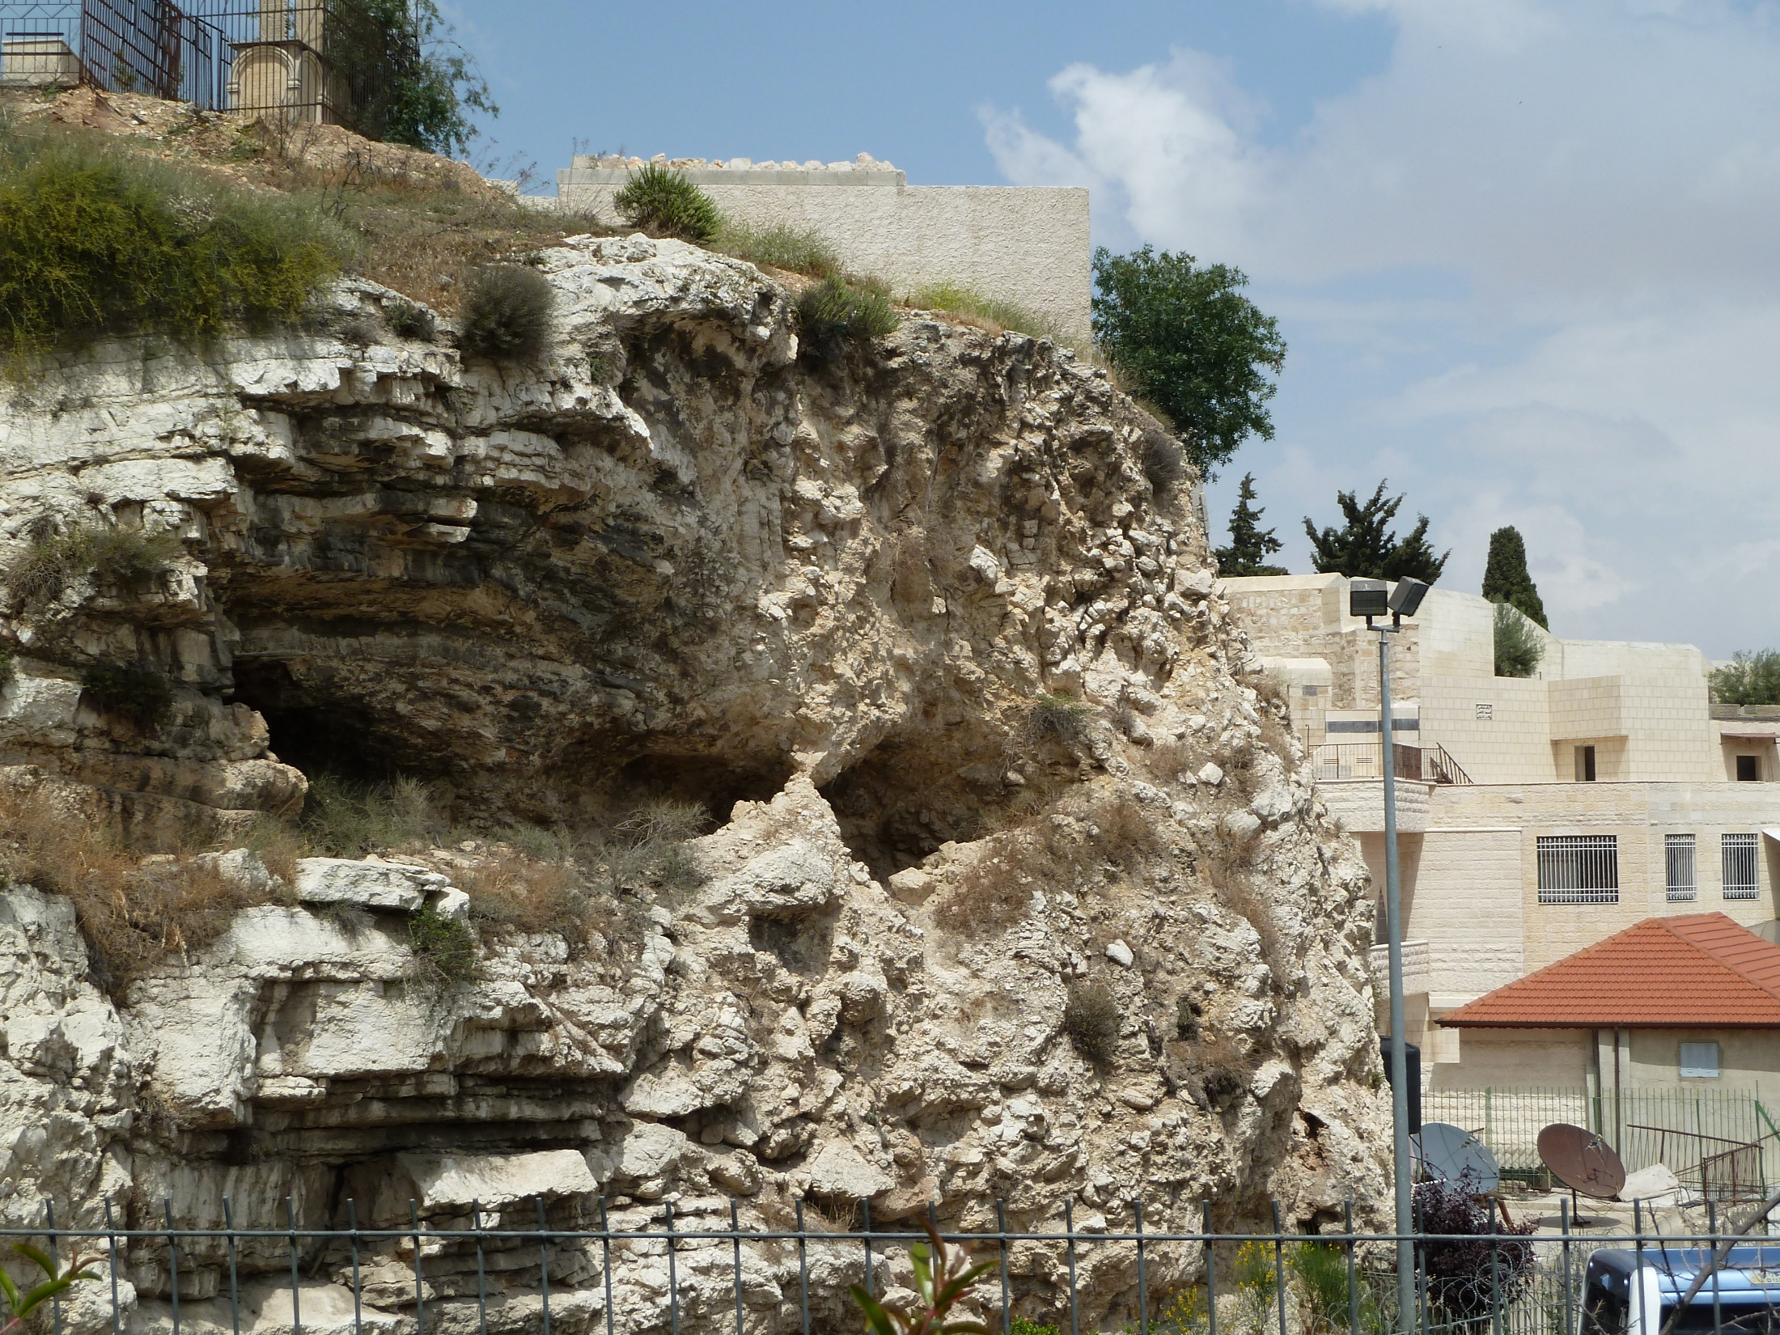
John 19.16-18 ESV: So he delivered him over to them to be crucified. So they took Jesus, and he went out, bearing his own cross, to the place called The Place of a Skull, which in Aramaic is called Golgotha.
There they crucified him, and with him two others, one on either side, and Jesus between them.

Slide 3
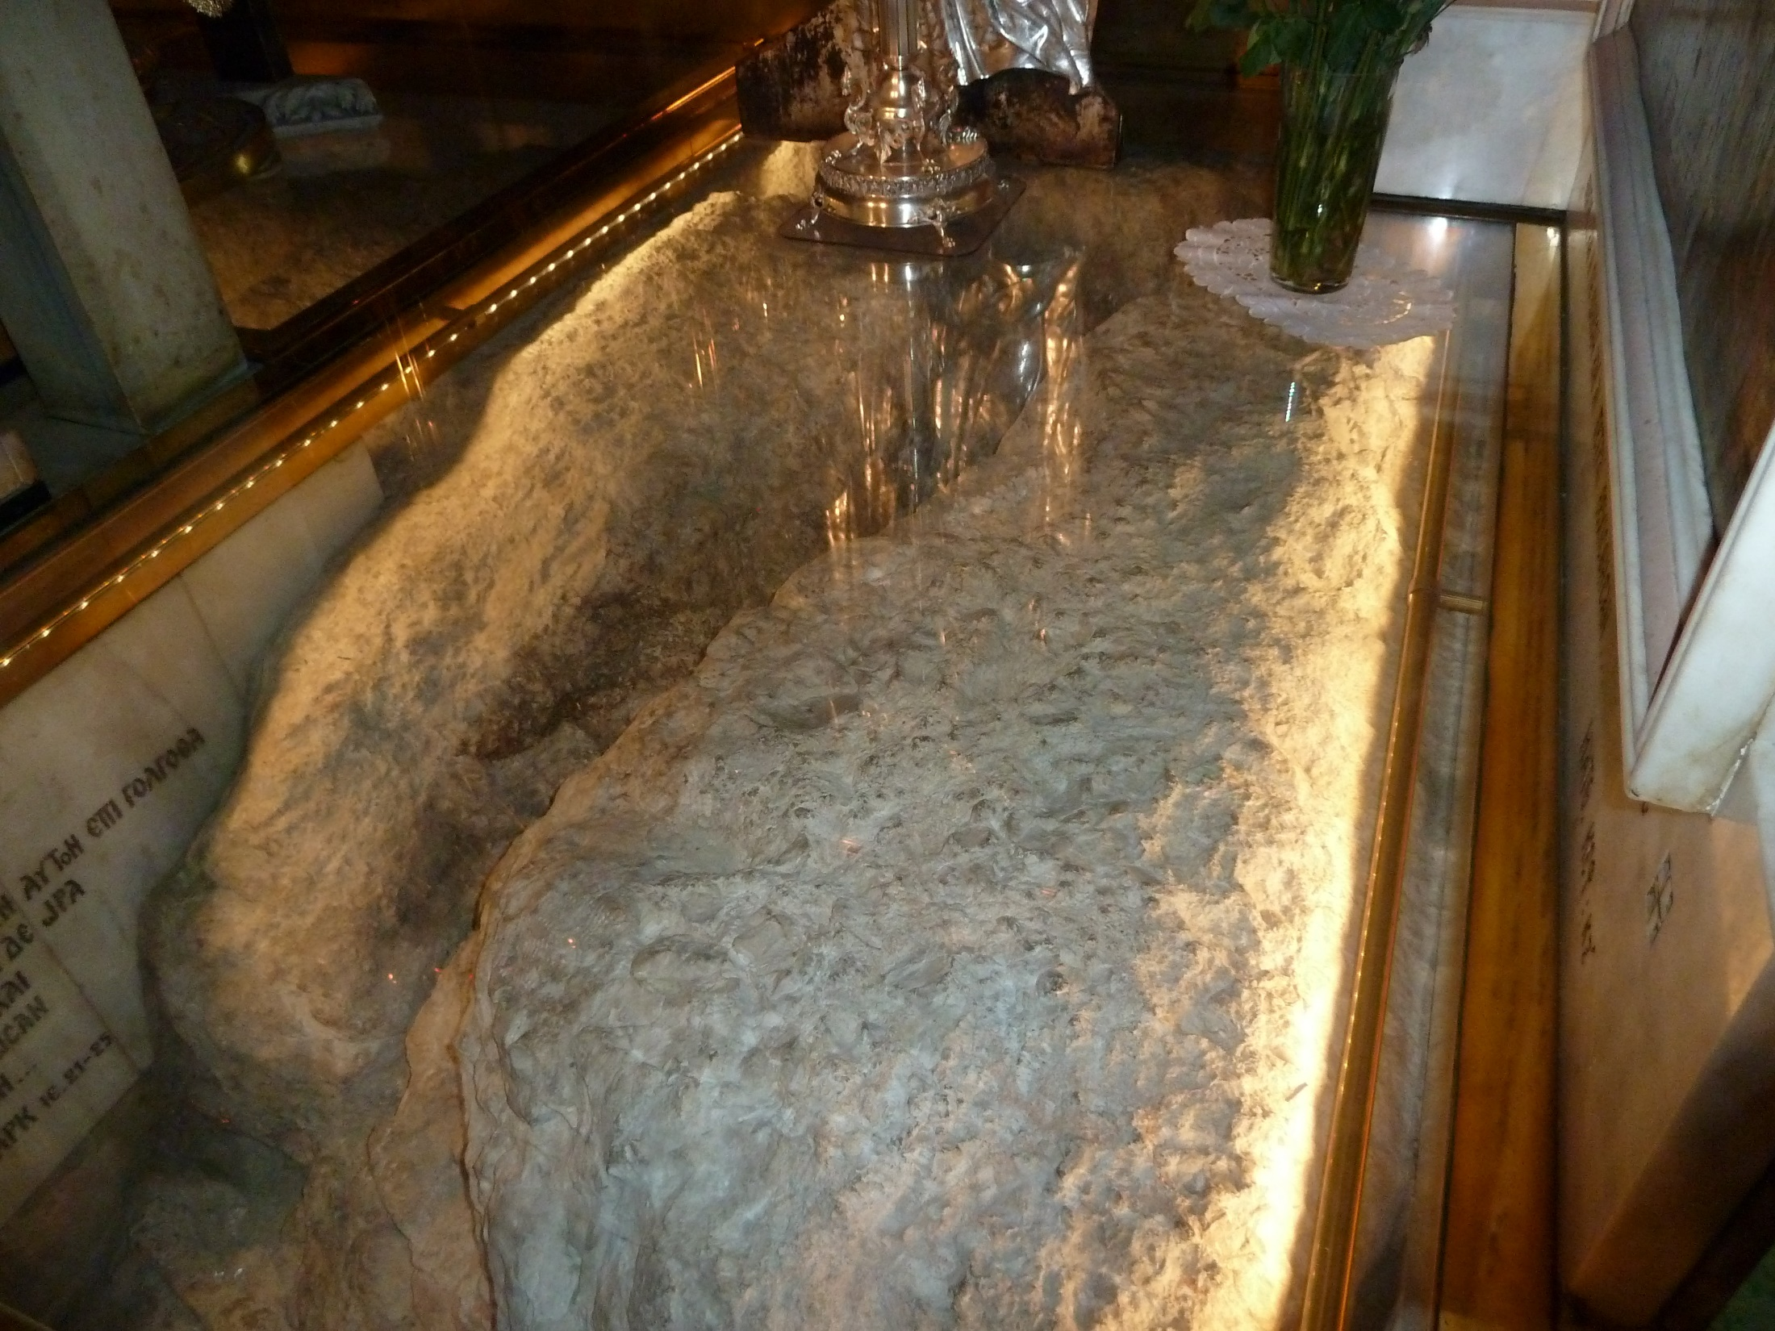
Crucifixion rock at Church of the Holy Sepulchre

Slide 4
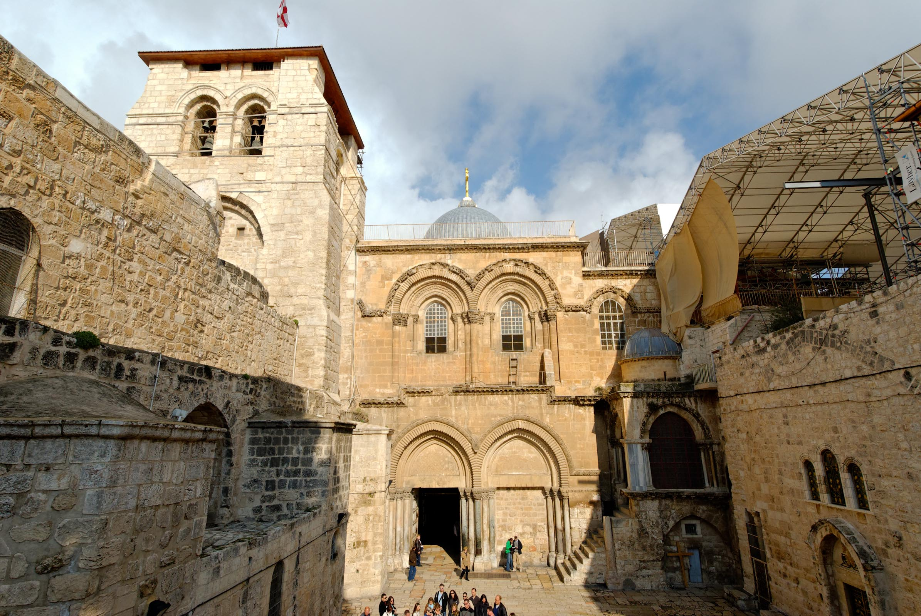
Church of the Holy Sepulchre
image by Todd Bolen / BiblePlaces.com

Slide 5
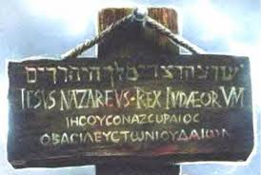
John 19.19-22: Pilate also wrote an inscription and put it on the cross. It read, “Jesus of Nazareth, the King of the Jews.” Many of the Jews read this inscription, for the place where Jesus was crucified was near the city, and it was written in Aramaic, in Latin, and in Greek. So the chief priests of the Jews said to Pilate, “Do not write, ‘The King of the Jews,’ but rather, ‘This man said, I am King of the Jews.’” Pilate answered,
“What I have
written I have
written.”

Slide 6
…it was written in Aramaic, in Latin, and in Greek.

Slide 7
John 19.23-24: When the soldiers had crucified Jesus, they took his garments and divided them into four parts, one part for each soldier; also his tunic. But the tunic was seamless, woven in one piece from top to bottom, so they said to one another, “Let us not tear it, but cast lots for it to see
whose it shall be.” This
was to fulfill the Scripture
which says, “They divided
my garments among them,
and for my clothing they
cast lots.”
Psalm 22.18

Slide 8
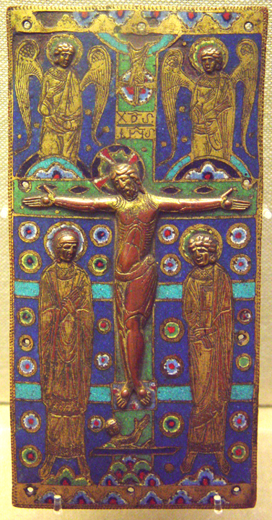
John 19.24b-27: So the soldiers [indeed] did these things, but standing by the cross of Jesus were his mother and his mother's sister, Mary the wife of Clopas, and Mary Magdalene. When Jesus saw his mother and the disciple whom he loved standing nearby, he said to his mother, “Woman, behold, your son!” Then he said to the disciple, “Behold, your mother!” And from that hour the disciple took her to his own home.
image from Vanderbilt.edu

Slide 9
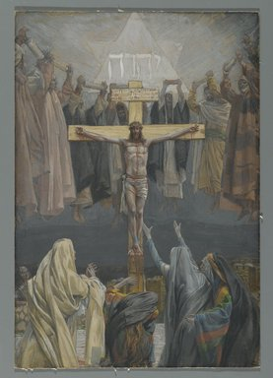
John 19.28-30: After this, Jesus, knowing that all was now finished, said (to fulfill the Scripture), “I thirst.” A jar full of sour wine stood there, so they put a sponge full of the sour wine on a hyssop branch and held it to his mouth. When Jesus had received the sour wine, he said, “It is finished,” and he bowed his head and gave up his spirit.
Tissot; BrooklynMuseum.com

Slide 10
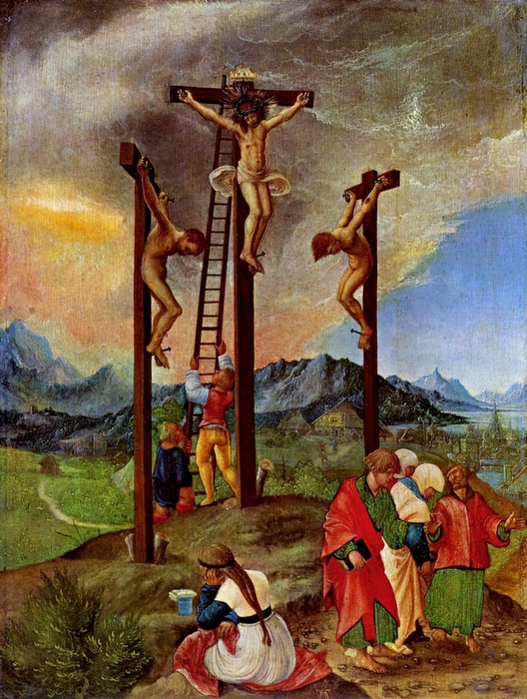
Justification:
God declares us to be righteous in his sight.
Imputed righteousness: God accounts to us the righteousness of Christ.
Albrecht Altdorfer; Vanderbilt.edu

Slide 11
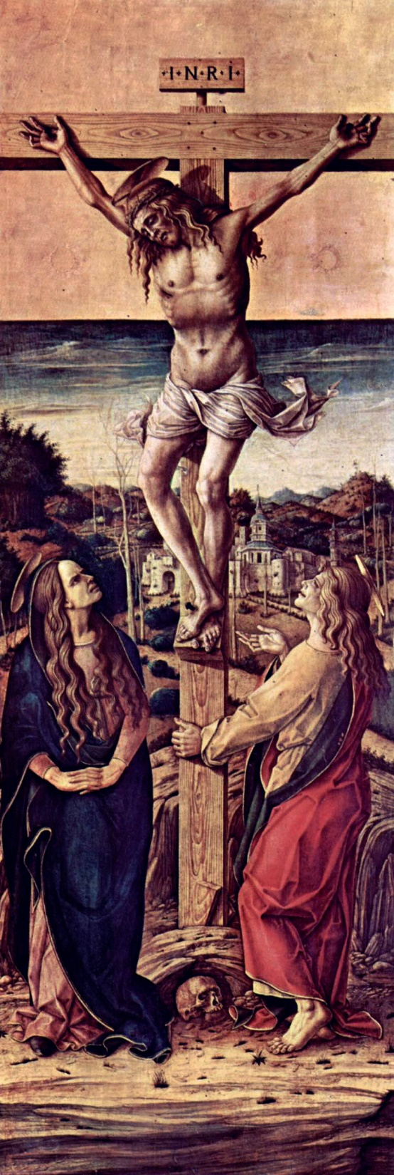
John 3.16 NIV: For God so loved the world that he gave his one and only Son, that whoever believes in him shall not perish but have eternal life.
John 20.30-31 NIV: Jesus performed many other signs in the presence of his disciples, which are not recorded in this book. But these are written that you may believe that Jesus is the Messiah, the Son of God, and that by believing you may have life in his name.
Carlo Crivelli; Vanderbilt.edu

Slide 12
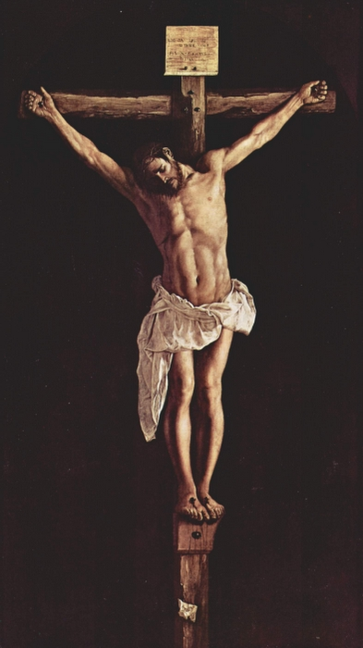
Francisco de Zurbaran Vanderbilt.edu

